Slide 1


AGE 316
MICROCOMPUTER SYSTEMS
LECTURE 9: ACTUATORS (MOTORS & SERVOS)
Dr. Kadeghe Fue
Department of Agricultural Engineering

Slide 2









Recap: The Control Loop
SENSE
THINK
ACT
Input (Sensors)
Process (Code)
Output (Actuators)
Today we focus on the "Hands" of the system.

Slide 3

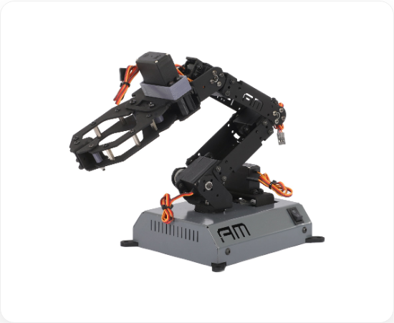
Concept: The Actuator
An actuator is a device that converts Electrical Energy into Physical Motion (Mechanical Energy).
•
Opening a valve.
•
Moving a robotic arm.
•
Spinning a fan.

Slide 4







Common Types of Actuators
DC Motor
Servo Motor
Stepper
Continuous rotation. High speed, low precision.
Precise rotation (0-180°). High torque, positioning.
Moves in precise "steps". Used in 3D printers/CNC.

Slide 5


The Current Limit Problem
STOP!
Can we connect a motor directly to Pin 13?
NO!
•
Arduino Pin Limit: 40 mA (max)
•
Small DC Motor: 200 mA - 1000 mA
Magic Smoke = Bad
Result: You will fry your Arduino.

Slide 6

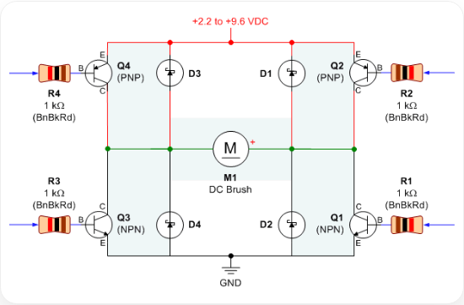
The Solution: A Digital Switch
The Transistor
We use a component like a MOSFET or BJT (NPN) to act as a bridge.
•
Arduino sends a small signal (low current).
•
Transistor opens the gate for a large power source (high current) to flow to the motor.

Slide 7


Protection: The Flyback Diode
Inductive Kickback
Motors are inductors. When you turn them OFF, they resist the change and shoot a high-voltage spike backwards.
The Diode
Essential for protecting your transistor!
We place a diode in reverse bias across the motor. It gives this spike a safe path to circulate until it dissipates.

Slide 8
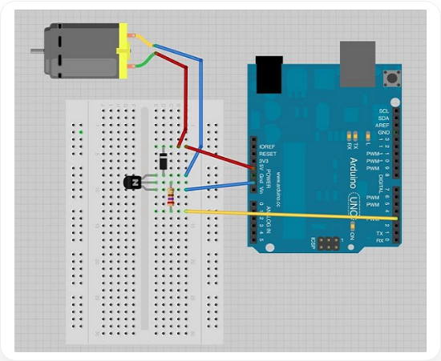
1. DC Motors
Characteristics
•
Two wires (+ and -).
•
Spin continuously when powered.
•
Reverse Direction: Swap polarity (+ to -, - to +).
•
Speed Control: Vary voltage (PWM).

Slide 9
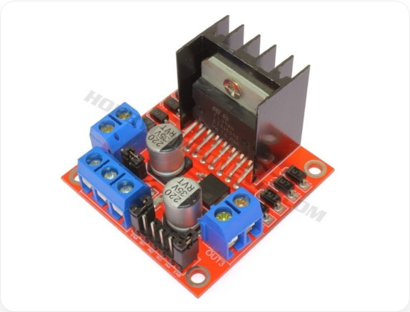
The H-Bridge
To reverse a motor automatically, we use a circuit called an H-Bridge.
L298N Module
A popular H-Bridge driver for Arduino.
•
Can drive 2 DC motors.
•
Allows Forward, Backward, and Stop.
•
Allows Speed control via Enable pins.

Slide 10

Controlling Speed (PWM)
We use analogWrite() to control the speed of the motor driver.
// Pin 9 connected to Enable Pin on Driver
int
9
void
loop
// Run at 50% Speed
analogWrite
127
delay
2000
// Run at Full Speed
analogWrite
255
delay
2000

Slide 11
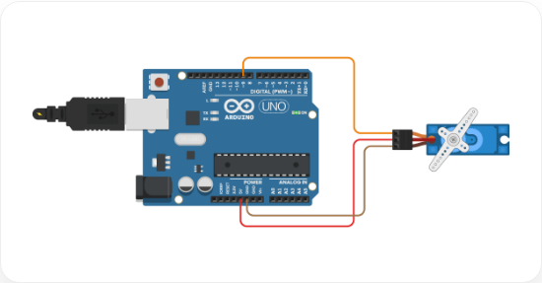
2. Servo Motors
Smart Motors
A servo contains:
•
A small DC motor.
•
Gears (for torque).
•
A potentiometer (for position feedback).
•
Control circuitry.
Input: You tell it an angle (e.g., 90°), and it goes there and stays there.

Slide 12





Wiring a Servo
Servos usually have 3 wires:
BROWN/BLK
RED
ORANGE/YEL
GND (Ground)
VCC (5V)
Signal (PWM Pin)
Note: Small servos (SG90) can run off Arduino 5V. Large ones need external power.

Slide 13


The Servo Library
Controlling servos requires complex timing pulses. Arduino makes it easy with a library.
// 1. Include the library
// 2. Create Servo Object
Servo
void
setup
// 3. Attach to Pin 9
attach

Slide 14


Code: Moving the Servo
We use the write() function to set the angle.
void
loop
// Move to 0 degrees
write
0
delay
1000
// Move to 90 degrees
write
90
delay
1000
// Move to 180 degrees
write
180
delay
1000

Slide 15


3. Stepper Motors (Overview)
Ultimate Precision
Moves in discrete "steps" (e.g., 1.8° per step).
•
Used in 3D Printers, CNC machines.
•
Requires a driver (ULN2003, A4988).
Step 1.. Step 2.. Step 3..
•
Can hold position with high torque.

Slide 16





Ag-Engineering Applications
Irrigation
Greenhouse
Robotics
Using Solenoid Valves (Actuator) to turn water flow on/off.
Using Servos to open windows for ventilation automatically.
Using DC Motors for wheels on an autonomous weeding robot.

Slide 17





Summary
DC Motors
Servos
Safety
Spin fast. Need H-Bridge (L298N) for control. Use PWM for speed.
Precise angles. Easy to use with Servo.h library.
Never power motors directly from Arduino pins! Use drivers.

Slide 18

Questions?
"The only stupid question is the one you don't ask."
Dr. Kadeghe Fue
Sokoine University of Agriculture

Slide 19






Image Sources
http://www.amrobotics.in/cdn/shop/products/ARM1.jpg?v=1648102783
Source: www.amrobotics.in
https://www.robotroom.com/BipolarHBridge/BipolarHBridgeSchematic.gif
Source: www.robotroom.com
https://www.tutorialspoint.com/arduino/images/dc_motor_connections.jpg
Source: tutorialspoint.com
https://hobbycomponents.com/2604-large_default/l298n-dual-h-bridge-driver-module.jpg
Source: hobbycomponents.com
https://www.makerguides.com/wp-content/uploads/2020/08/servo-motor-with-arduino-uno-wiring-diagram-schematic-circuit-tutorial.png
Source: makerguides.com

